Slide 1
Introduction to Programming in Python

Slide 2
Making decisions in Python

Slide 3
Conditional Statements in Python
Majority of the time when programming, you would need to control the flow of your logic. Our program will want to perform an action in only certain cases, we can use the if, elif, and else statements to control for these cases.

Slide 4
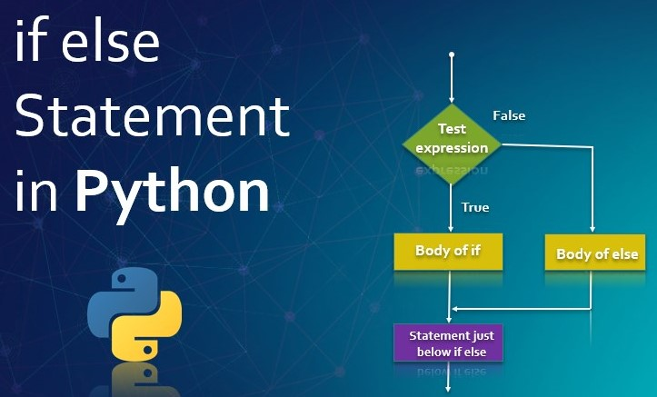

Slide 5
The if and else statement syntax
The format for an if else statement is
if expression:
Statement 1
else:
Statement 2
The if statement checks whether the expression evaluates to True, and if so, the statement 1 is executed, otherwise the statement 2 is executed. Note the indentation before the statement 1 and 2 and the colon (:) in the if expression and else.
Comparison operators (==, !=, <, >, <=, >=) and logical operators (and, or, not) will be useful.

Slide 6

Lab session

